Slide 1

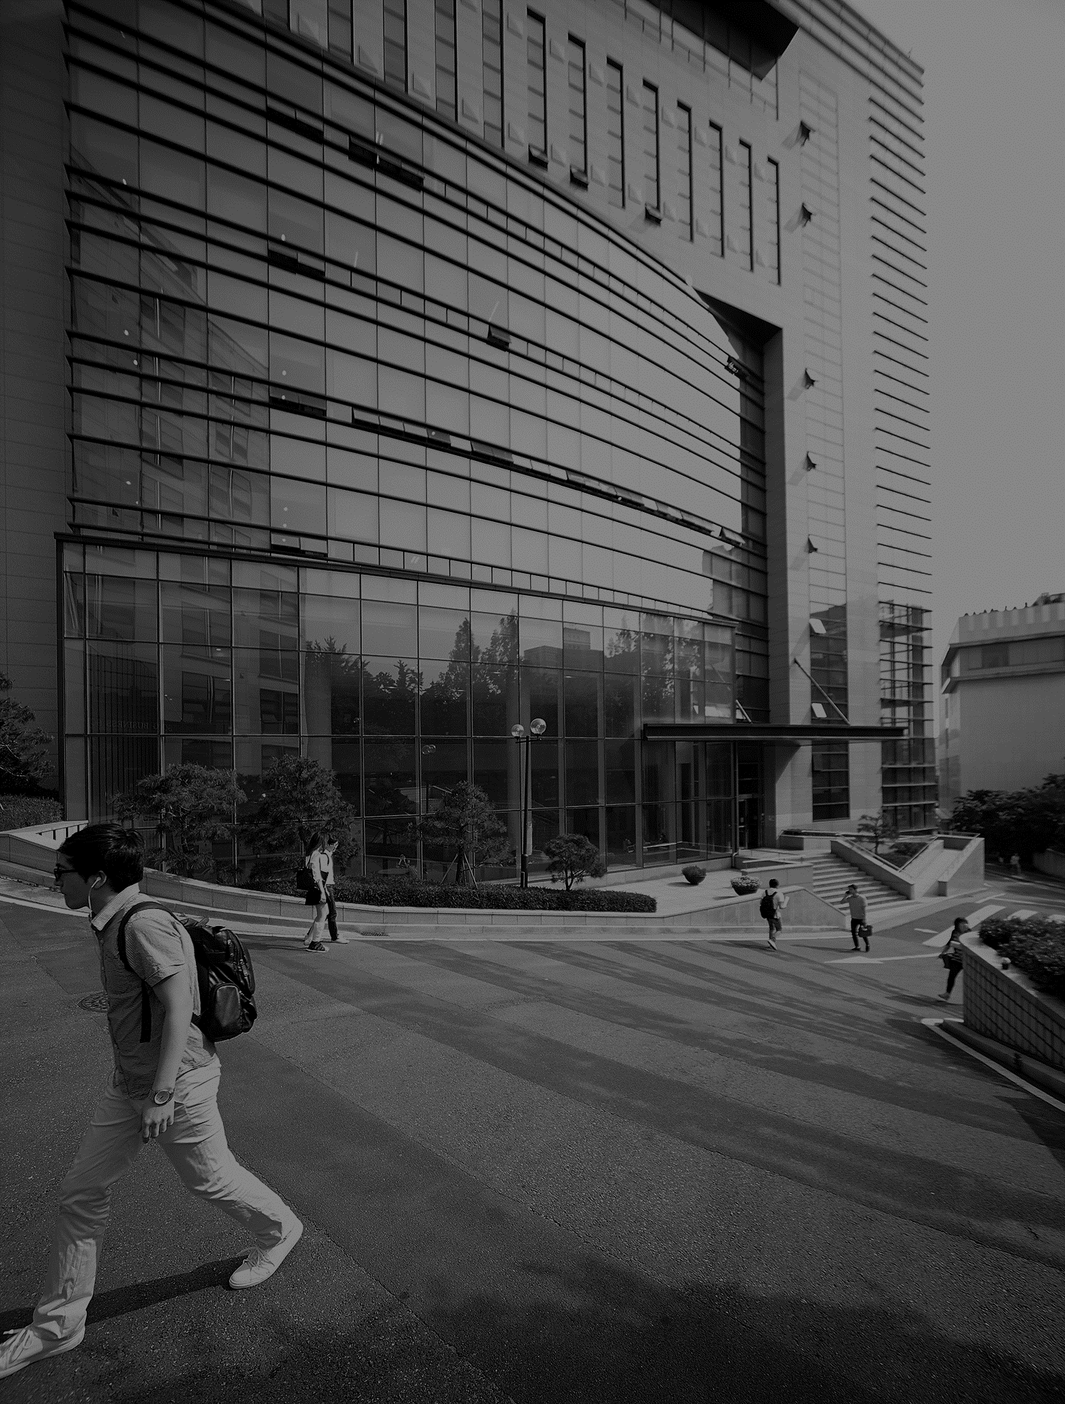
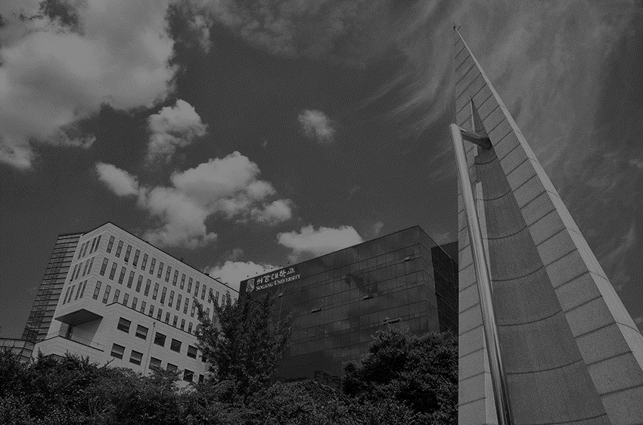
기초 딥러닝
지도교수 : 정성원교수님
학번 : 120230234
이름 : 박선민

Slide 2

Contents
Project
Data sets
Model
Result

Slide 3
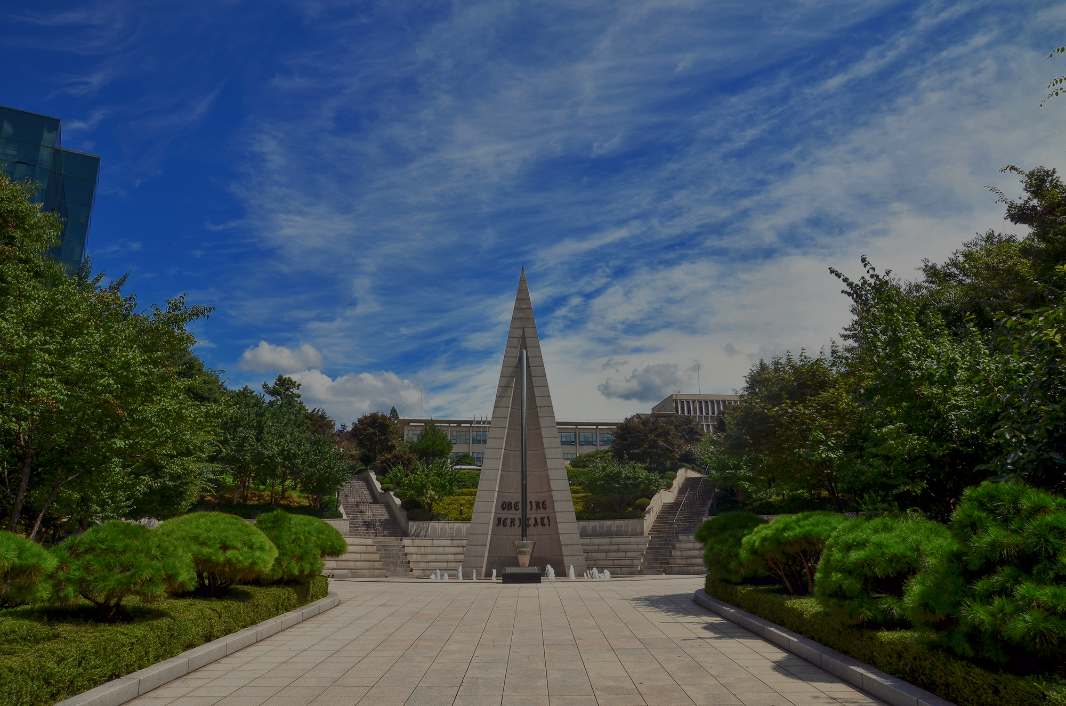
Fire Smoke Detection
Project

Slide 4
Project
Goal
To determine whether is a fire through the sensor-based smoke detection
Model
CNN model
Data sets
Row : 15
Column : 62,630
Target Variable : Fire Alarm
0 : 44,757(71%) It means the alarm didn’t sound
1 : 17,813(29%) It means the alarm sounded

Slide 5
Fire Smoke Detection
Data sets

Slide 6
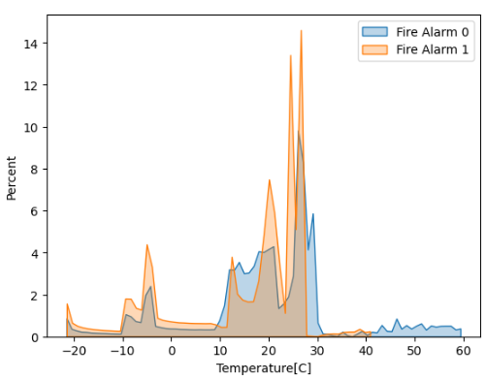
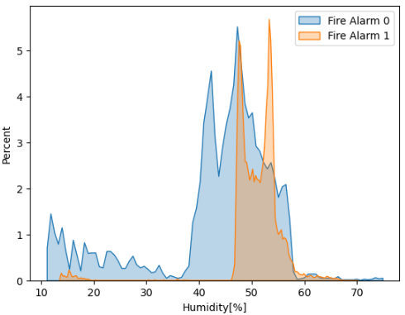
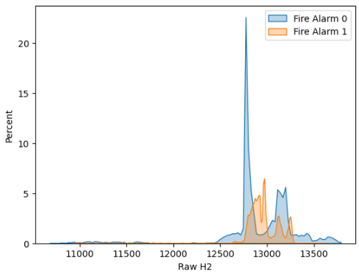
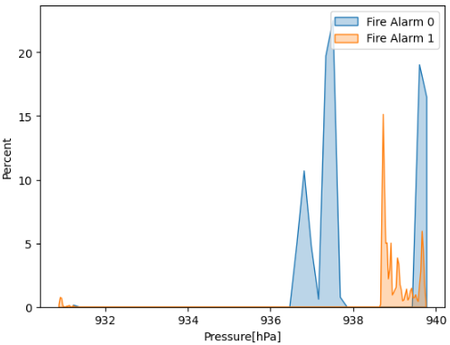
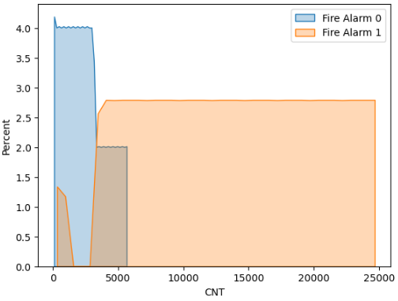
Data sets
Column
Temperature Humidity RawH2 Pressure CNT

Slide 7
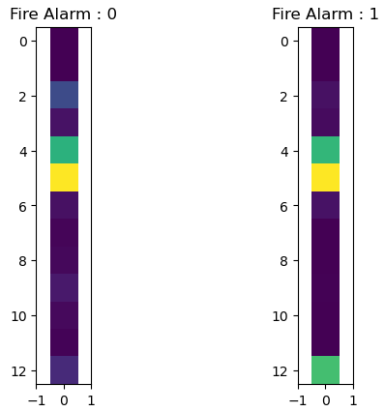
Data sets
Target Variable(Fire Alarm)
Visualize the ‘Fire Alarm’ to image (13,1)

Slide 8
Fire Smoke Detection
Model

Slide 9
Model
Input shape
(13, 1)
Split Data set
Train dataset : 40,083(64%)
Validation dataset : 10,021(16%)
Test dataset : 12,526(20%)
Activation function
Convolution layers : relu
Last Dense layer : sigmoid
Loss
Binary crossentropy

Slide 10
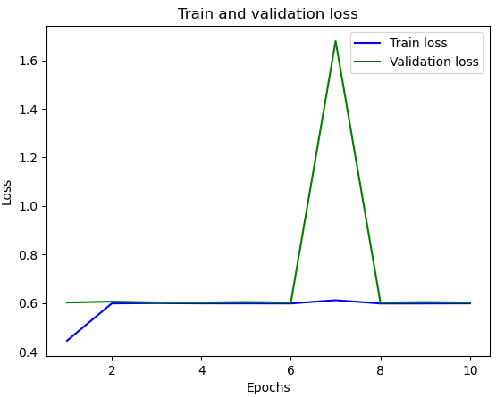
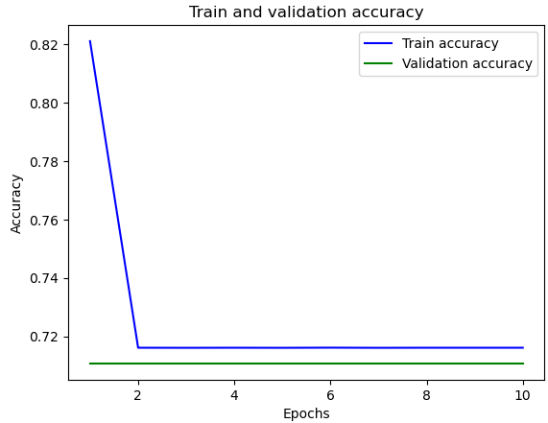
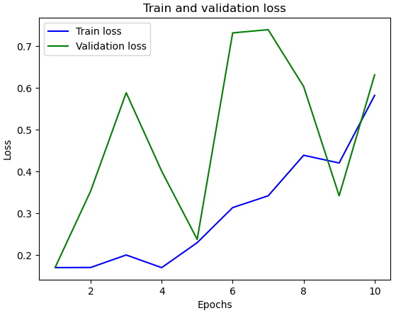
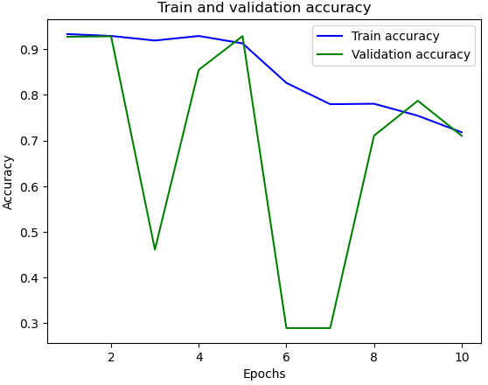
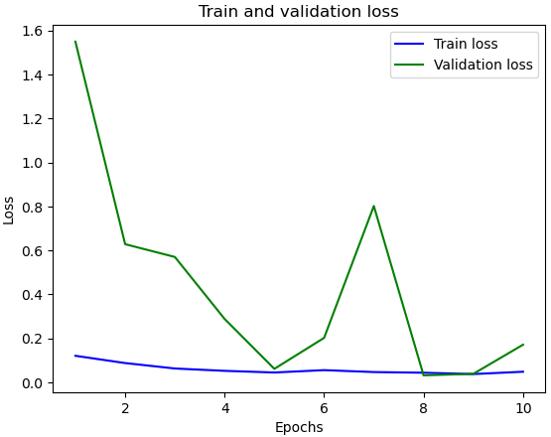
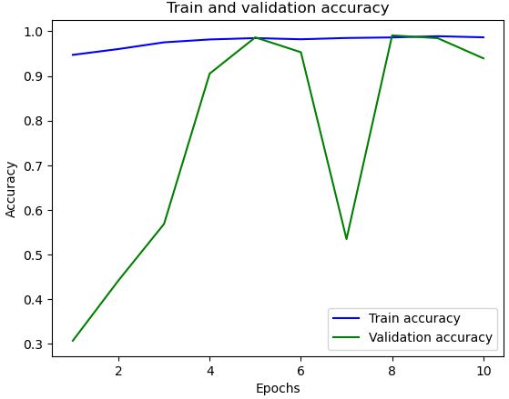
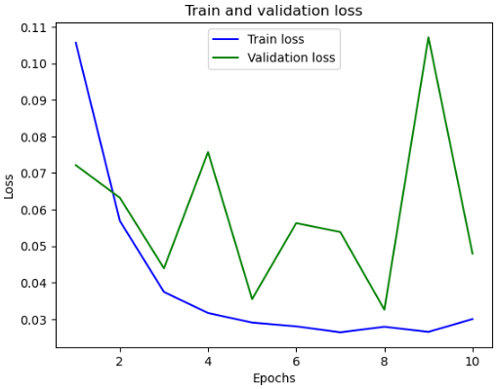
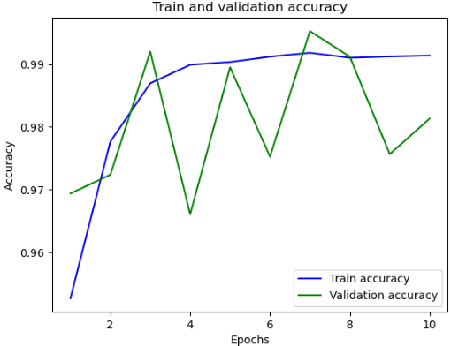
Model
4 CONVOLUTIONS (15 layers)
Tuning learning rate to 0.05, 0.025, 0.01, 0.005
CONV1D
channel 32, kernel 5
<learning rate 0.05> Test loss 0.5994 Test accuracy 0.7131 | <learning rate 0.025> Test loss 0.6304 Test accuracy0.7131
<learning rate 0.01> Test loss 0.6005 Test accuracy 0.7131 | <learning rate 0.005> Test loss 0.042 Test accuracy 0.9881
BATCHNORMALIZATION
CONV1D
channel 64, kernel 3
BATCHNORMALIZATION
MAXPOOLING1D
BATCHNORMALIZATION
CONV1D
channel 128, kernel 3
DROPOUT
BATCHNORMALIZATION
CONV1D
channel 64, kernel 3
DROPOUT
MAXPOOLING1D
FLATTEN
DENSE 128
DENSE 1

Slide 11
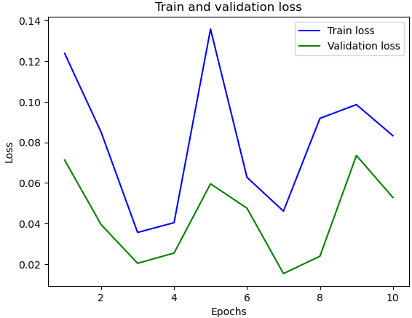
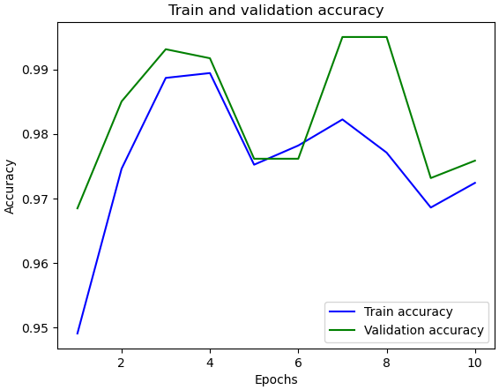
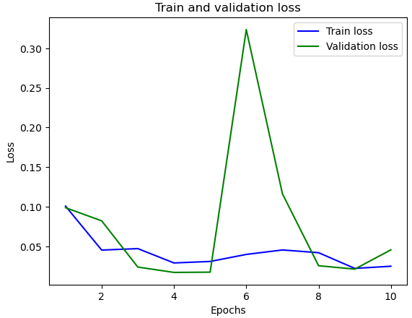
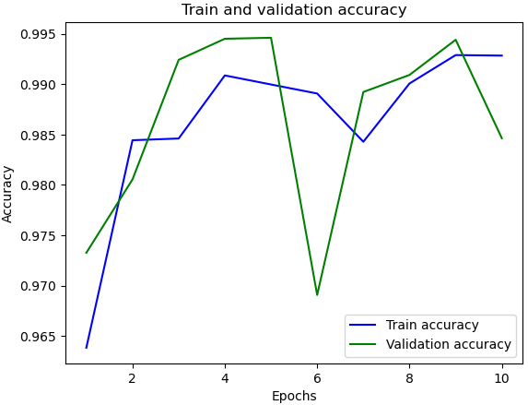
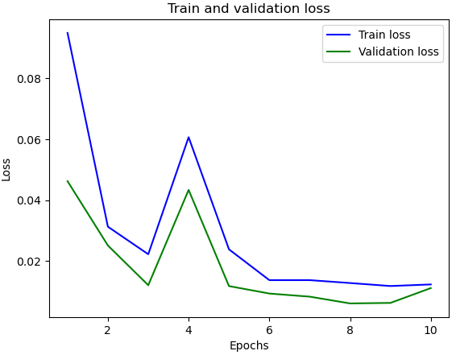
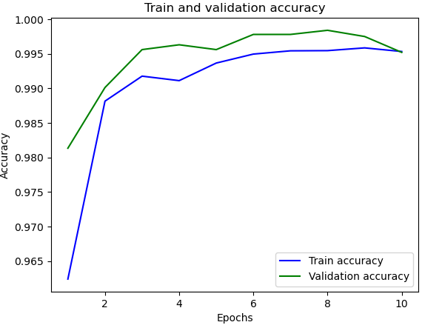
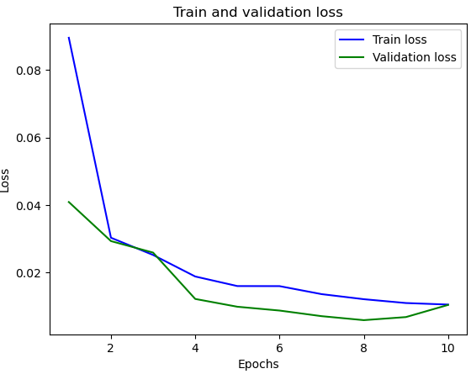
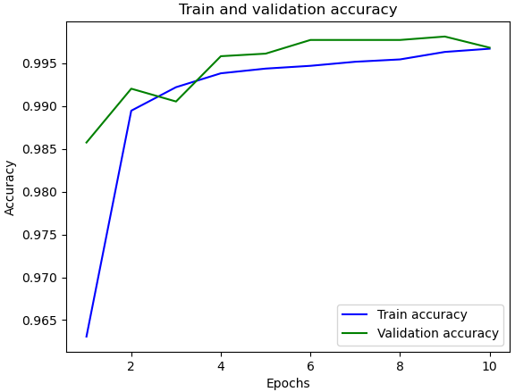
Model
1 CONVOLUTION (5 layers)
Tuning learning rate to 0.05, 0.025, 0.01, 0.005
<learning rate 0.05> Test loss 0.0536 Test accuracy 0.9743 | <learning rate 0.025> Test loss 0.0333 Test accuracy 0.9883
<learning rate 0.01> Test loss 0.0062 Test accuracy 0.9974 | <learning rate 0.005> Test loss 0.0076 Test accuracy 0.997
CONV1D
channel 64, kernel 5
MAXPOOLING1D
FLATTEN
DENSE 128
DENSE 1

Slide 12
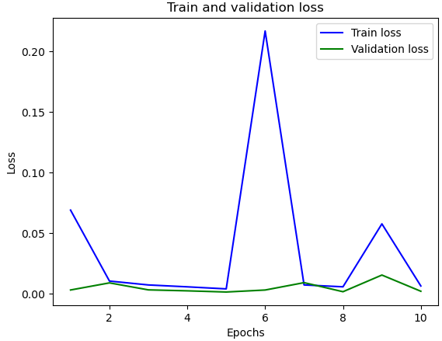
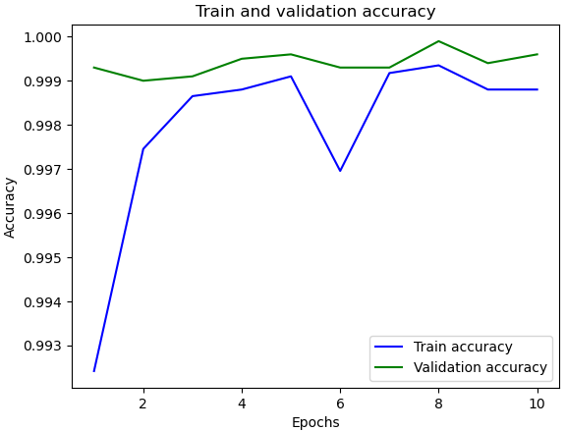
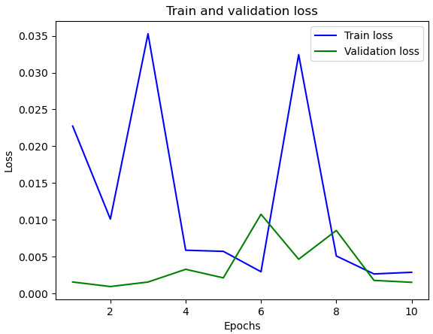
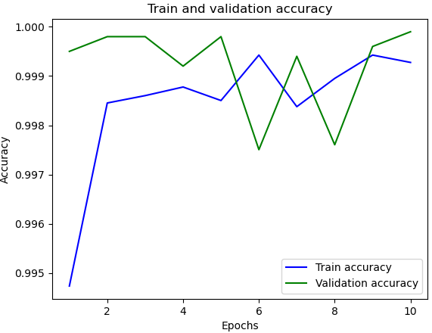
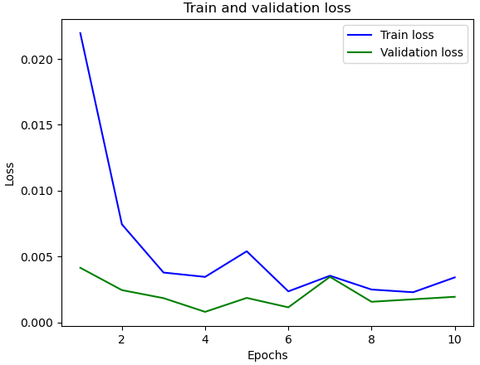
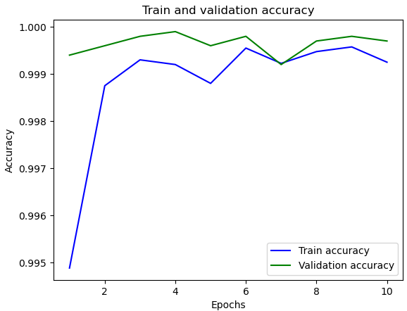
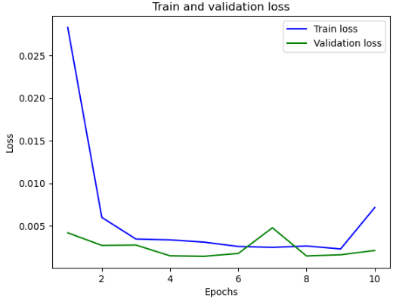
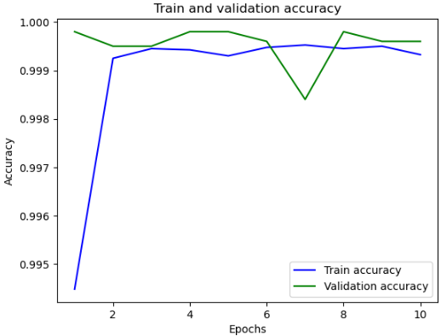
Model
2 DENSE (3 layers)
Tuning learning rate to 0.05, 0.025, 0.01, 0.005
<learning rate 0.05> Test loss 0.023 Test accuracy 0.9997 | <learning rate 0.025> Test loss 0.0003 Test accuracy 0.9999
<learning rate 0.01> Test loss 0.0012 Test accuracy 0.9998 | <learning rate 0.005> Test loss 0.0009 Test accuracy 0.9997
FLATTEN
DENSE 128
DENSE 1

Slide 13
Fire Smoke Detection
Result

Slide 14
Result
Select Model
2Dense (3 layers) Model
FLATTEN
DENSE 128
DENSE 1
Select learning rate
less than 0.025
-> 0.01, 0.005
Result
Learning rate 0.01 : loss(0.0012) accuracy(0.9998)
Learning rate 0.025 : loss(0.0009) accuracy(0.9997)

